Slide 1
Introduction to workshop

Slide 2

WHAT IS DESIGNING?
Designing is the practice of conceiving and planning an optimal way to perform a certain task.

Slide 3

WHY DESIGNING?
To simplify our manufacturing process
To save our time
To increase efficiency
To help us identify our end product

Slide 4






CAD SOFTWARES USED BY ENGINEERS TO DESIGN
Computer-aided design is a way to digitally create 2D drawings and 3D models of real-world products. With 3D CAD, you can share, review, simulate, and modify designs easily.

Slide 5
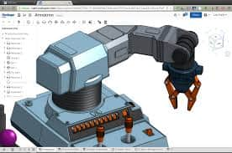
ONSHAPE
Onshape is an open-source web-based software system, delivered over the Internet.

Slide 6
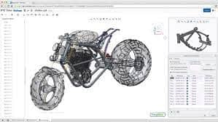
WHY ONSHAPE?
no downloads, license keys, or service packs required
users can create custom features
can be accessed on iOS and Android phones, tablets, and cross-platform web browsers
makes use of databases when storing data

Slide 7
HOW TO SIGN IN
Go to OnShape.com and register in the “education plan” as a student.
No charge to use OnShape as a student.
Google search “OnShape Education Plan”

Slide 8
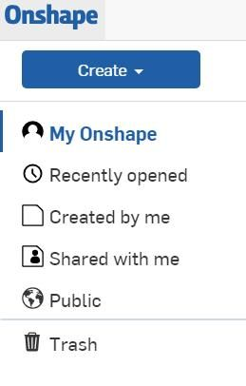
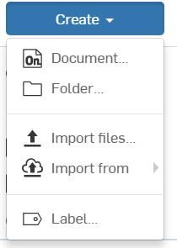
LET’S DO THIS!!!
1) Log in to OnShape account
2) Click “My OnShape”
3) Click “Create”
4) Select “Document” and name it “L-Bracket”

Slide 9
OBJECTIVES: BASIC SKETCHING PRACTICE
1. Practice sketching using a variety of sketch tools.
2. Practice applying constraints to sketch entities.
3. Learn when to apply a constraint vs a dimension to an entity.
4. Create a fully defined sketch.
5. Create a basic part by extruding the correct sketch face.

Slide 10
INTRODUCTION TO ONSHAPE
“1.1 - Software Overview and User Interface Tour.”
“1.2 - Parametric Modeling and Feature-Based Modeling.
“1.3 - Design Intent.”

Slide 11
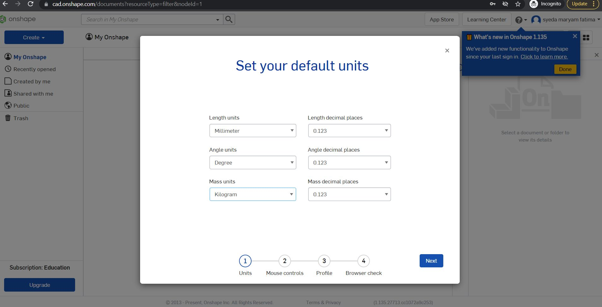

Slide 12
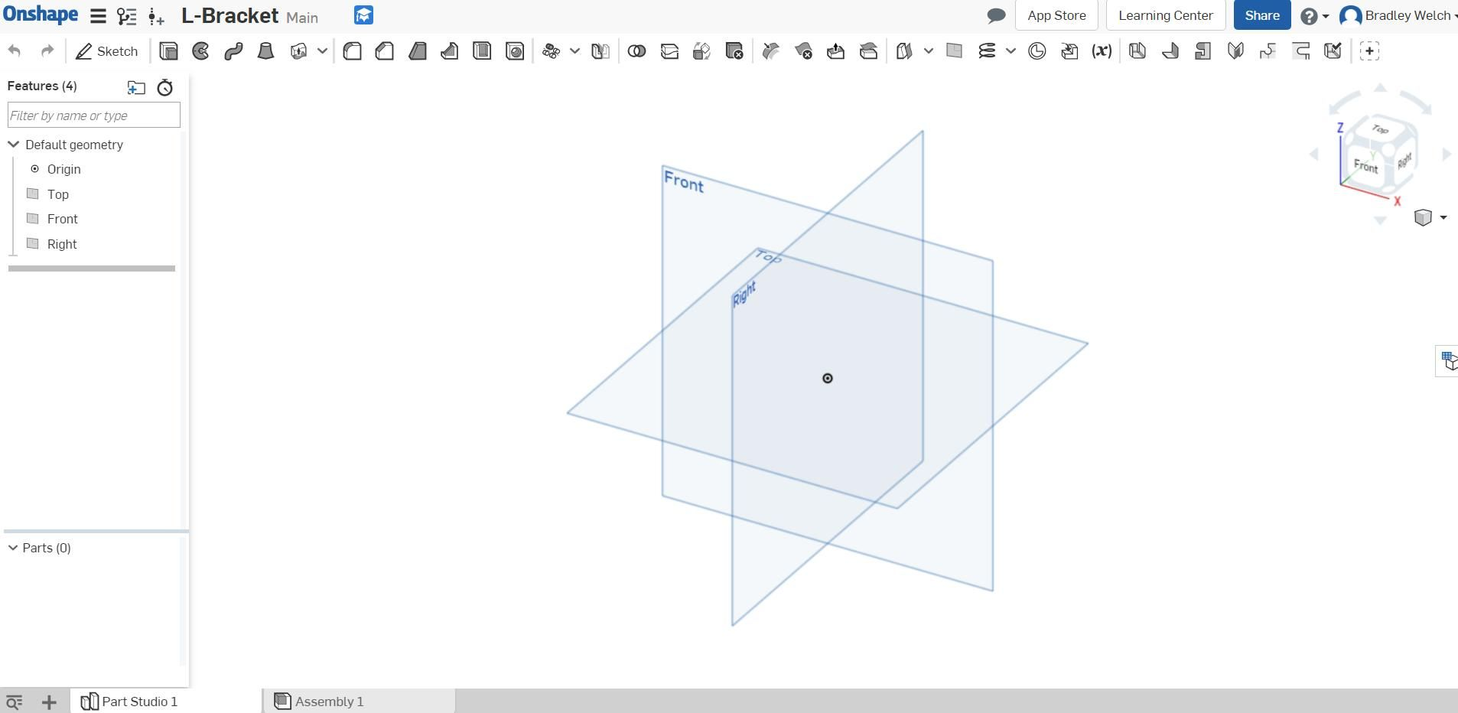

Slide 13
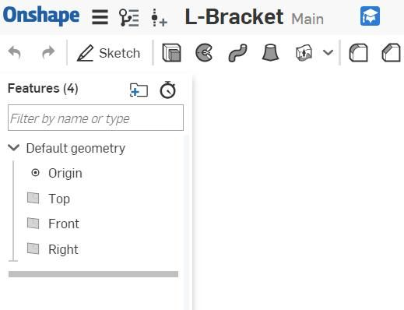
Viewing the proper side to sketch

Slide 14
2D&3D FEATURES
IN
ONSHAPE

Slide 15
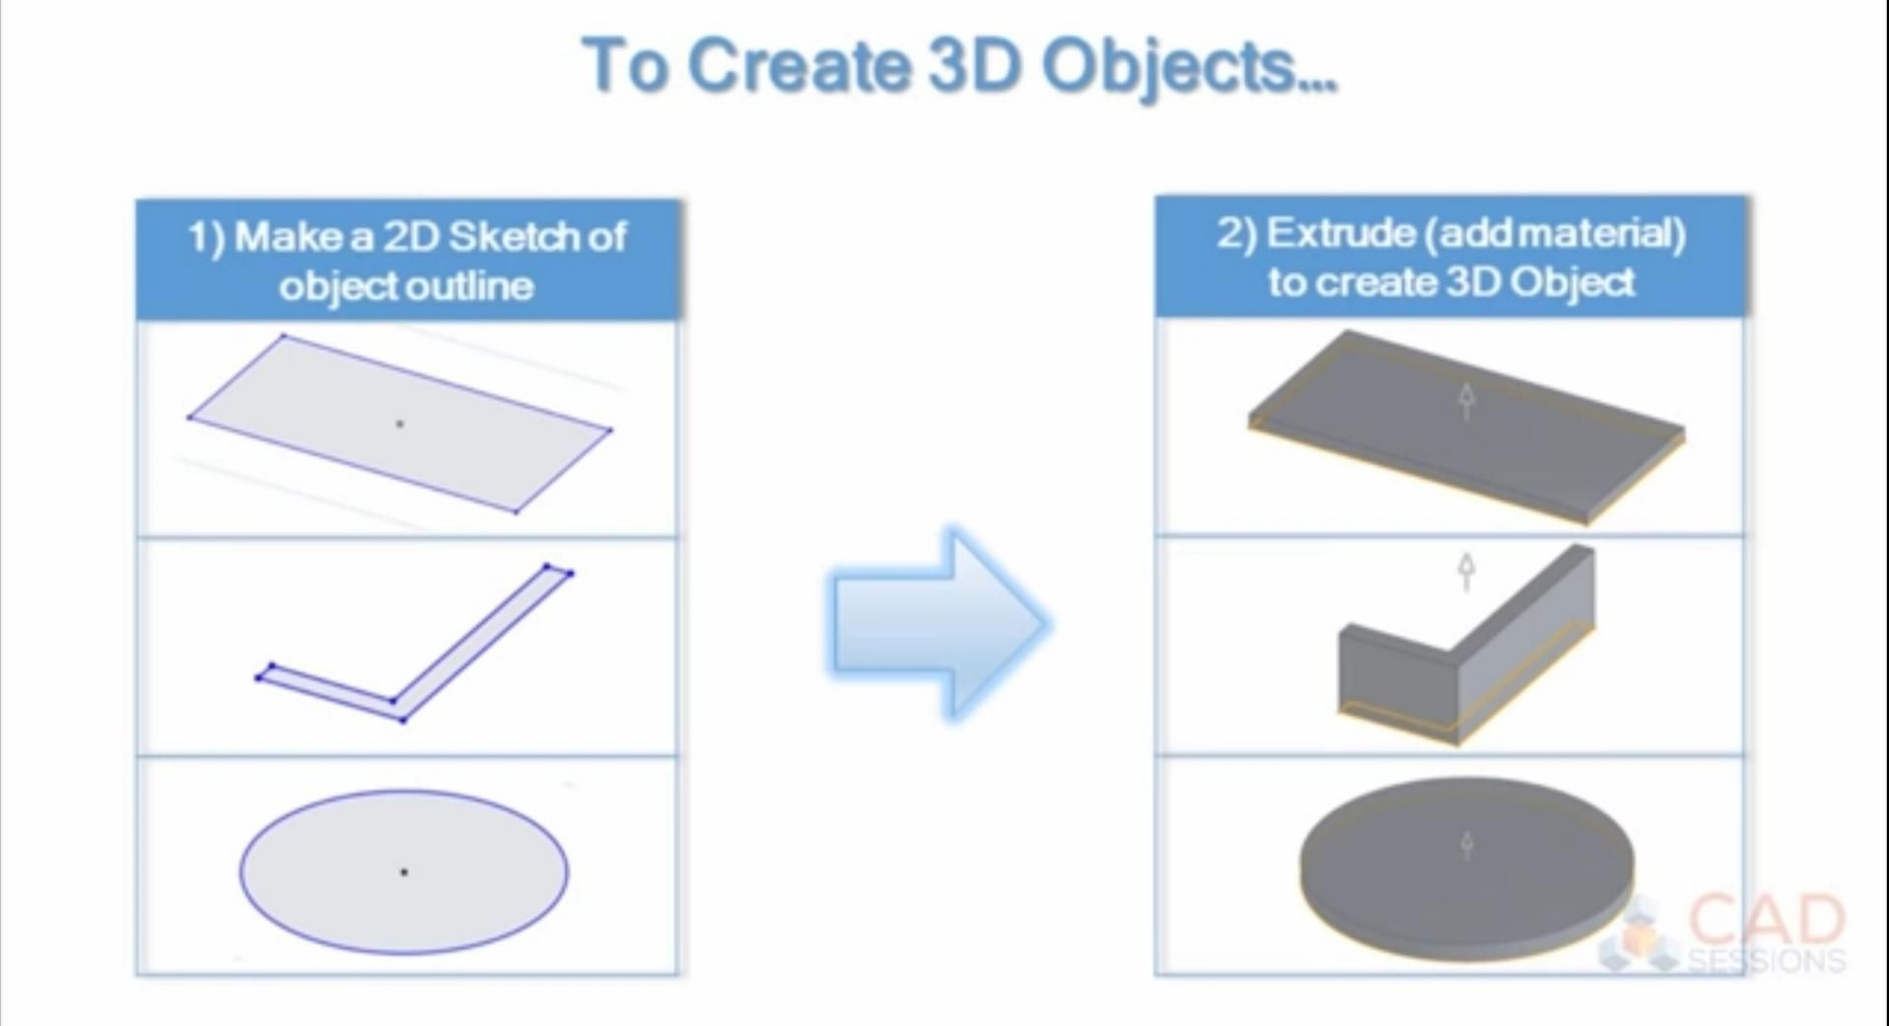

Slide 16
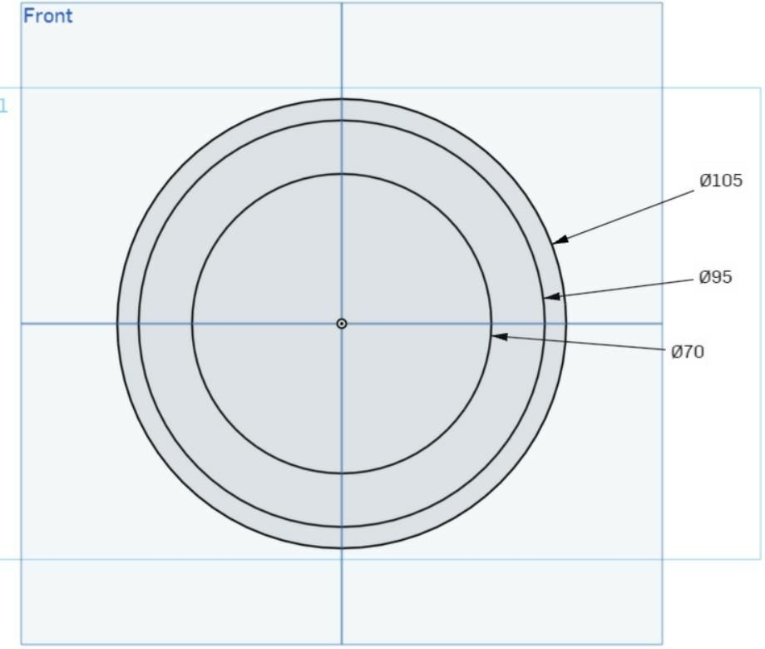
DIMENSIONING
Dimensions
2. Add dimensions to fully define the sketch geometry using the “Dimension Tool”
3. Experiment by selecting line segments, or combinations of lines and points as you place each dimension, and type in the values shown. (Hint: Be sure to select the top and bottom circles along the vertical line and make them equal. 0.75”)

Slide 17
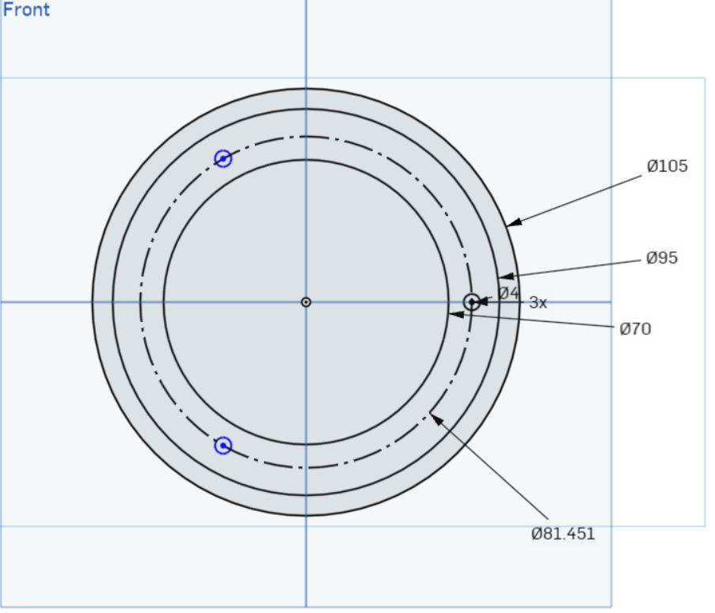

CONSTRUCTION TOOL
4. Change the vertical and horizontal lines to construction lines using the “Construction Tool

Slide 18
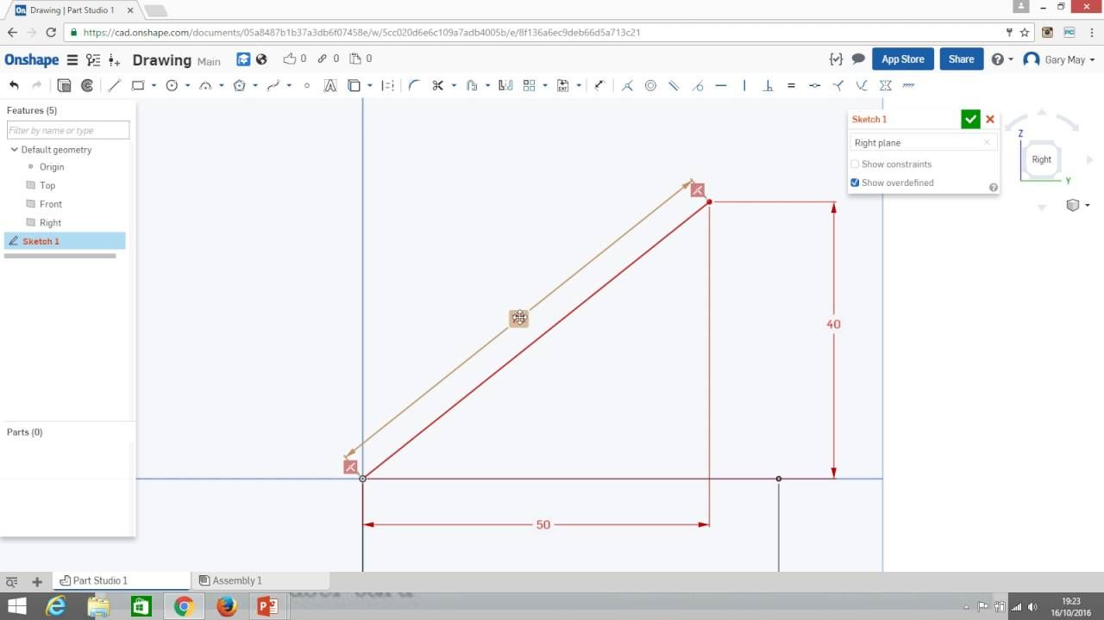
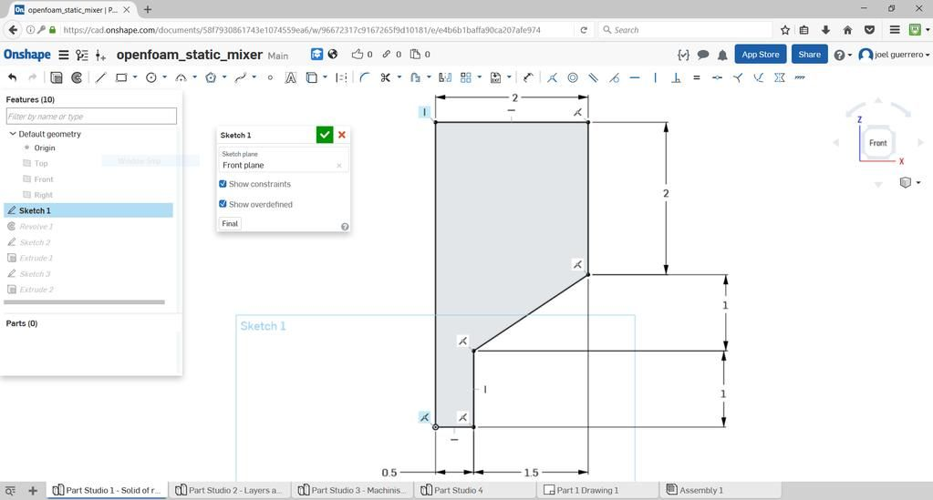
2D SKETCH

Slide 19
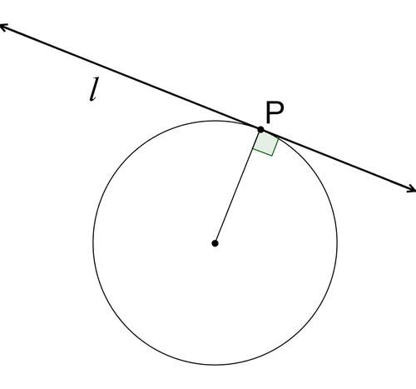
CONSTRAINTS
Constraints? Are basically limitations or restrictions that tell each line how to behave.
What is a “tangent line”?
Defined: A line that intersects a circle (or curve) at one single point.
Example “Line l is tangent to the circle at point P” Property: A tangent line is perpendicular to the radius of the circle

Slide 20
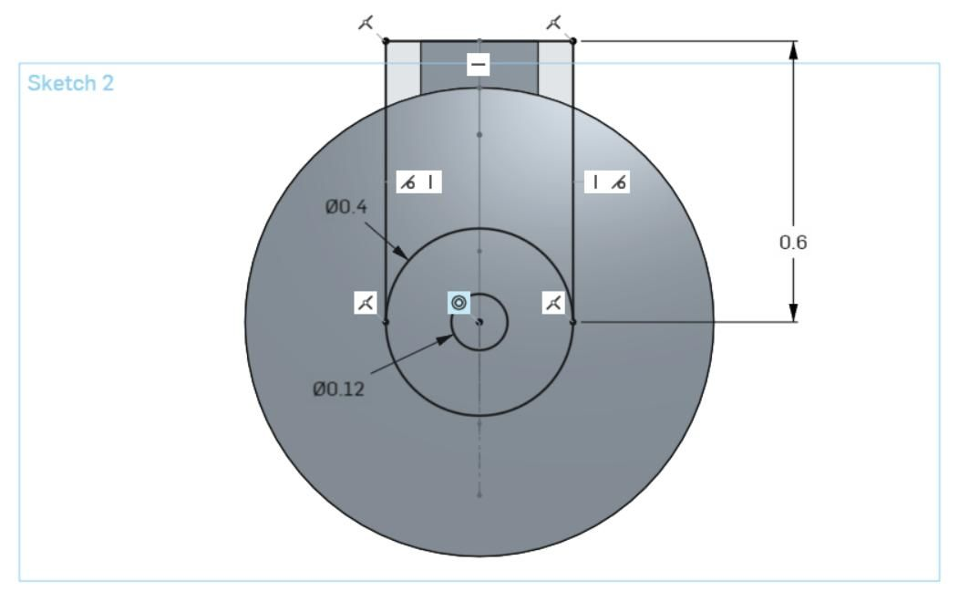
Same photo with constraints shown

Slide 21
• What did you notice that was
different from the first drawing that we did?
1. Measurements?
2. New tools introduced?
3. Face used?
4. Where was the origin?

Slide 22

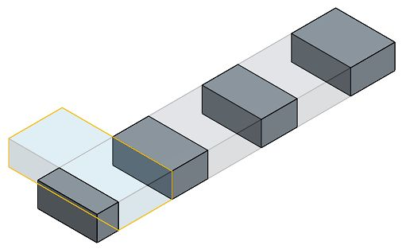
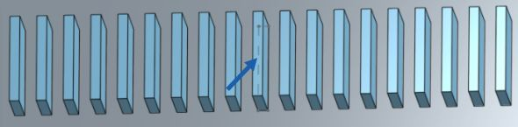

Slide 23
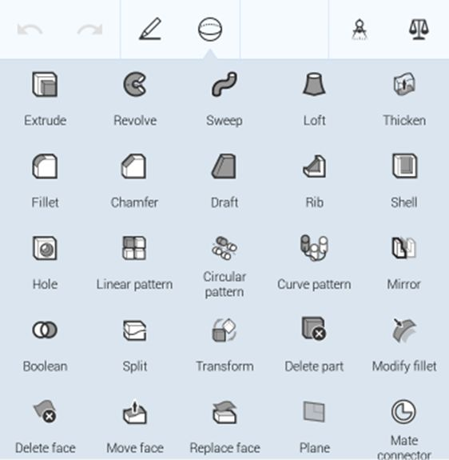
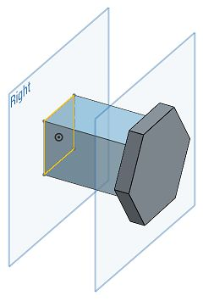
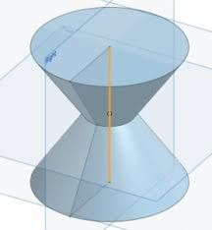
3D FEATURES IN ONSHAPE

Slide 24
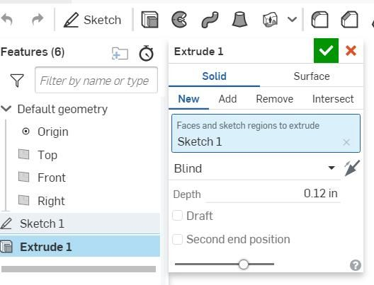
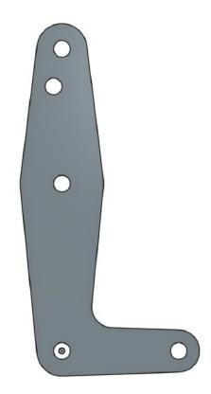
Ready to Extrude? (create a 3-dimesional part)
• 2.1-Extrude.

Slide 25
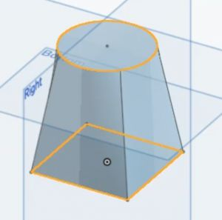
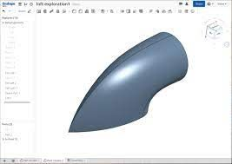
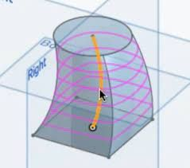

Slide 26
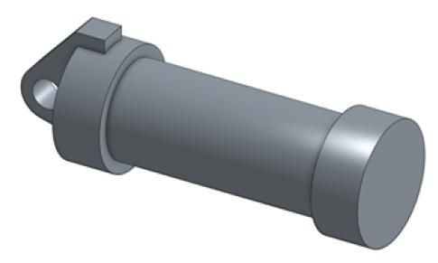
Revolve, Sweep, Fillet, and Chamfer
We will be creating a highly detailed version of this part.

Slide 27
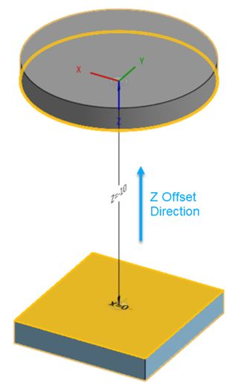
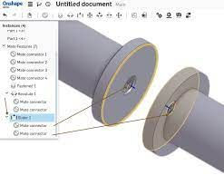
MATES
Mates contain their own coordinate systems, so you ever only need to use one Mate to define the degrees of freedom between two entities.

Slide 28
TYPES OF MANUFACTURING

Slide 29
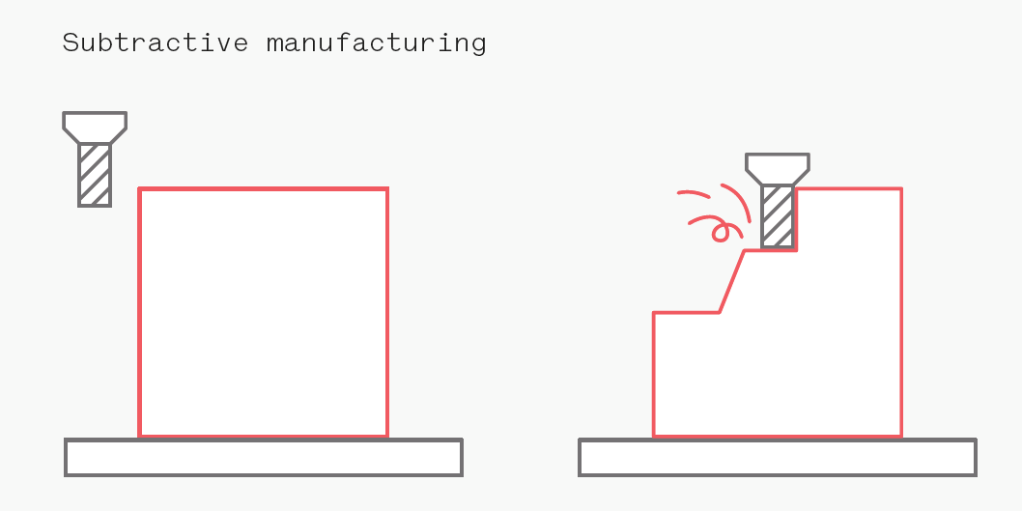


Slide 30

EXAMPLE OF SUBSTRACTIVE MANUFACTURING

Slide 31
ADDITIVE MANUFACTURING

Slide 32
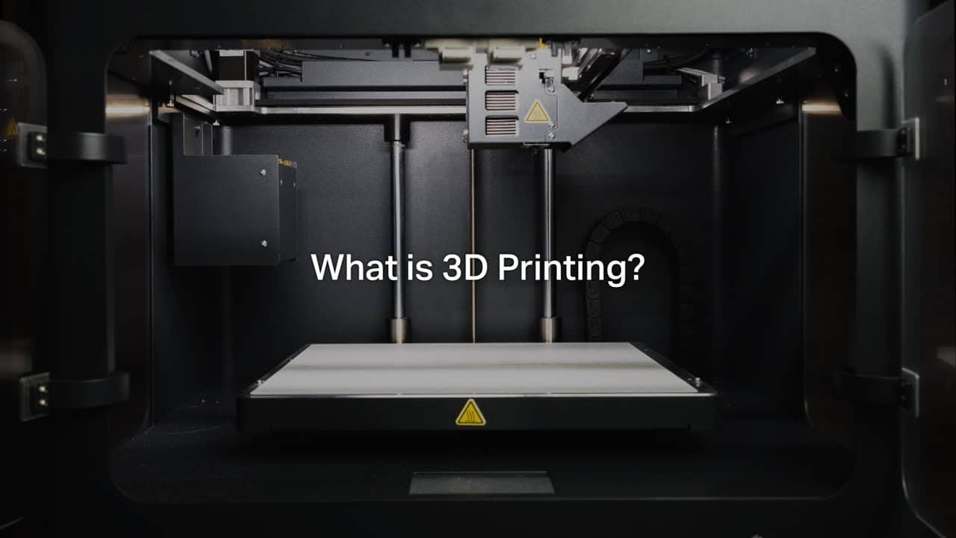

Slide 33
DIFFERENT TYPES OF 3D PRINTING
Material Extrusion
Vat Polymerization
Powder Bed Fusion

Slide 34
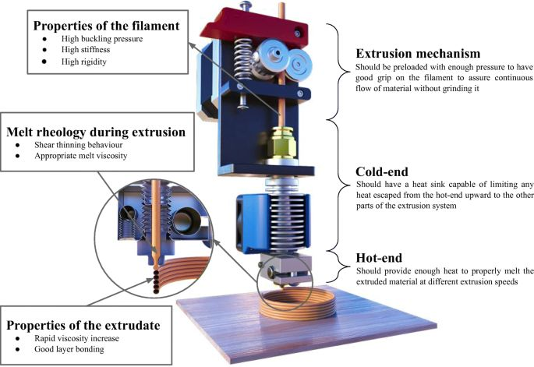
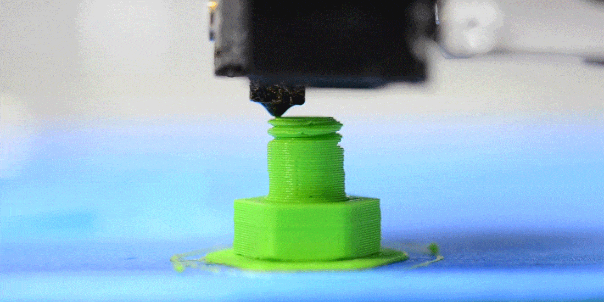
Material Extrusion

Slide 35
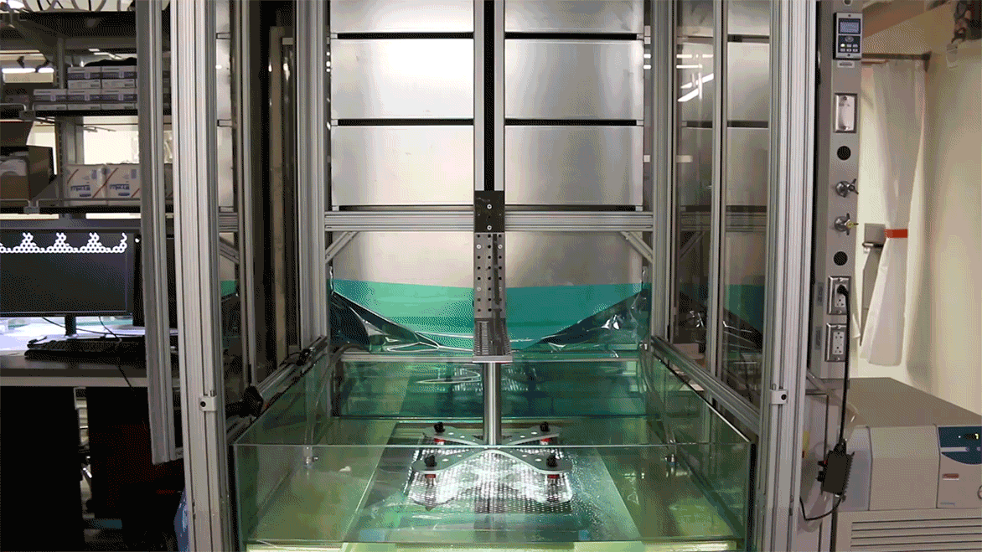
VAT POLYMERIZATION

Slide 36
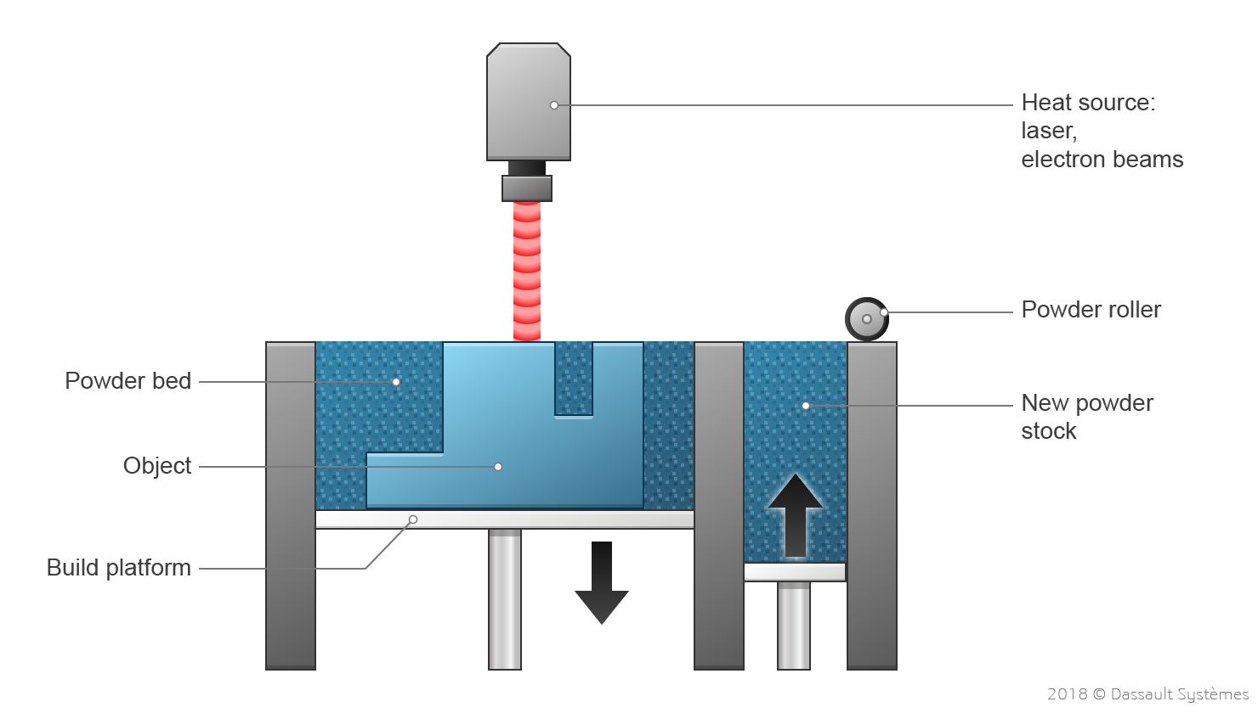
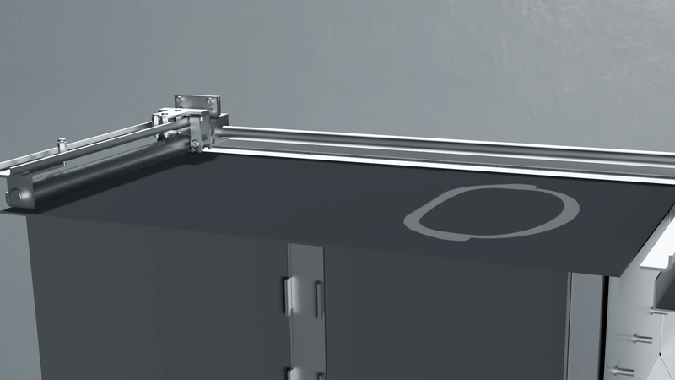
POWER BED FUSION

Slide 37
3D
Printing Technology
Practical Implementation on Cura

Slide 38
Common Methods for 3D Printing
FDM (Fusion Deposit Modelling)
SLA (Stereo Lithography)
SLS (Selective Laser Sintering)
Others

Slide 39



Slide 40
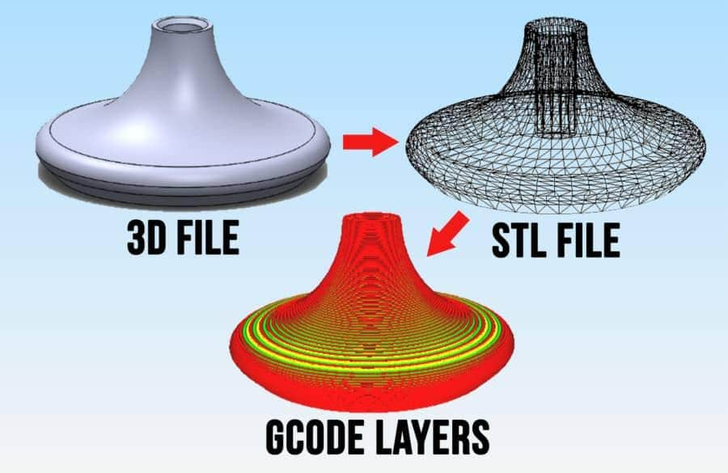
What is slicing?

Slide 41
Slicing softwares used
>>>Ultimaker Cura
>>>3DPrinterOS
>>>IdeaMaker
>>>OctoPrint
>>>Slic3r
>>>Astroprint

Slide 42
File Extensions supported by the slicing software
.STL
.OBJ
.VRML
.3MF
.AMF
.X3G
.FBX
.PLY

Slide 43
FEATURES OF CURA

Slide 44
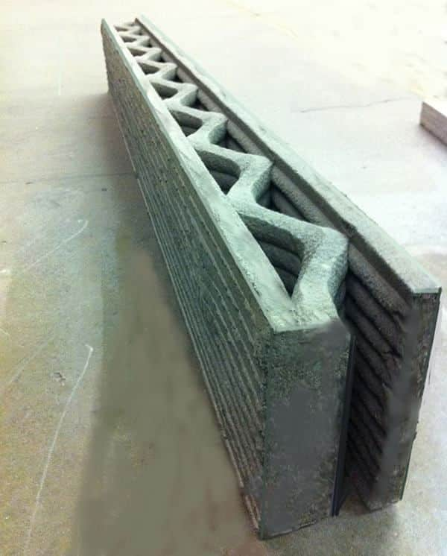
WALLS

Slide 45
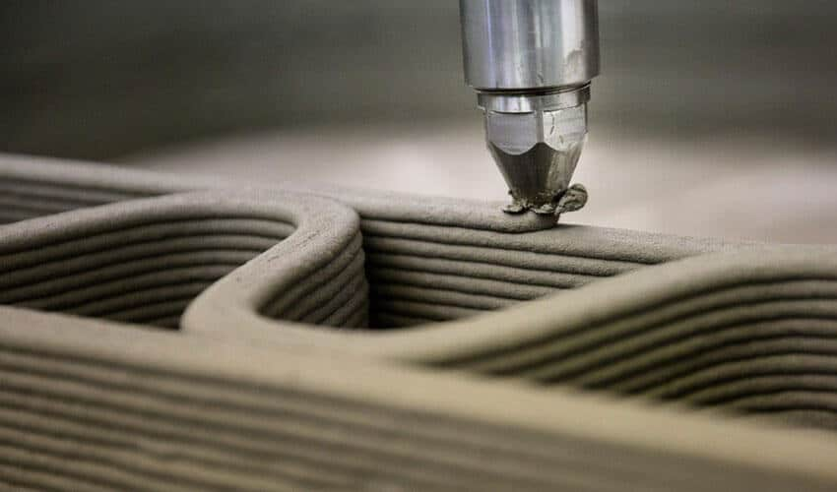
Layer Height

Slide 46
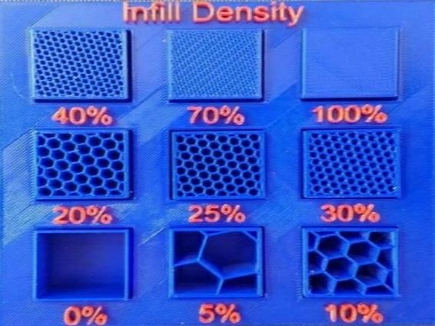
Infill Density

Slide 47
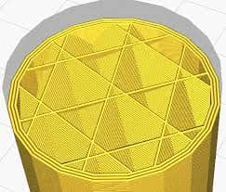
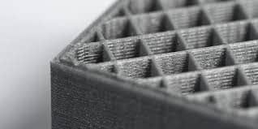
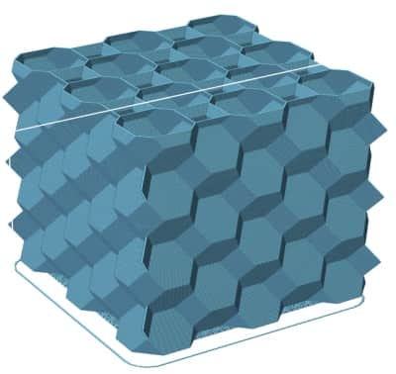
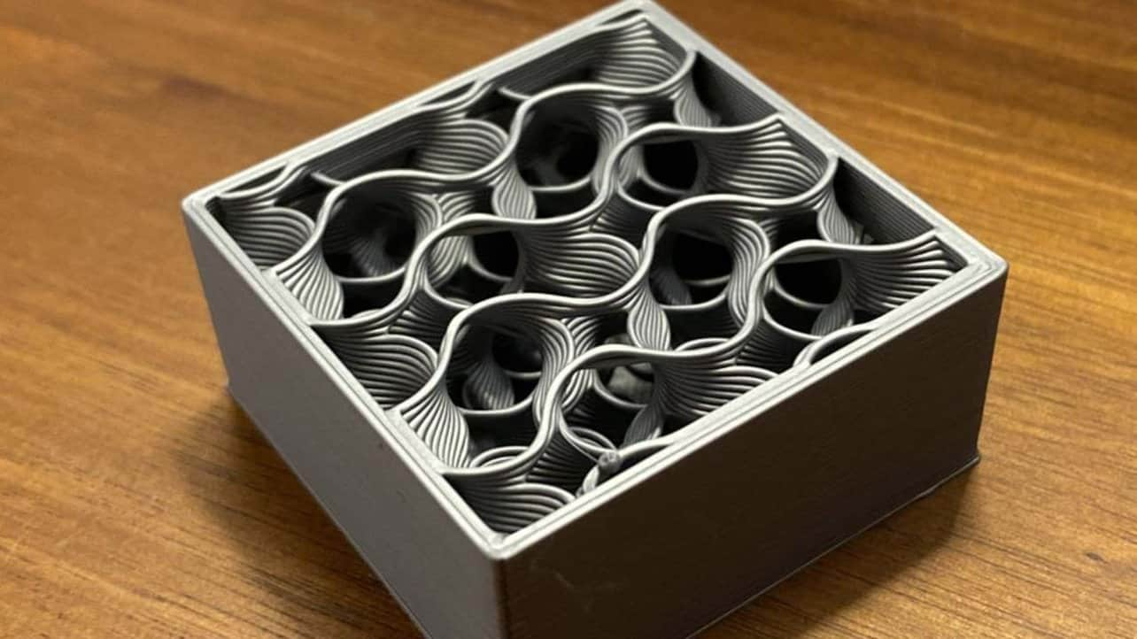
Common
Infills
Cubic
Grid
Gyroid
HoneyComb

Slide 48
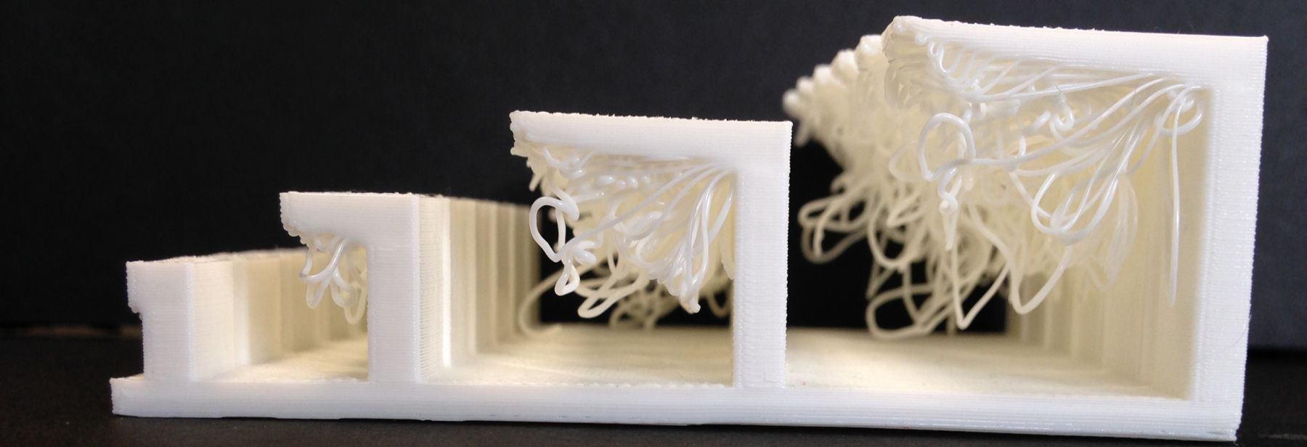
OVERHANGING PROBLEMS

Slide 49
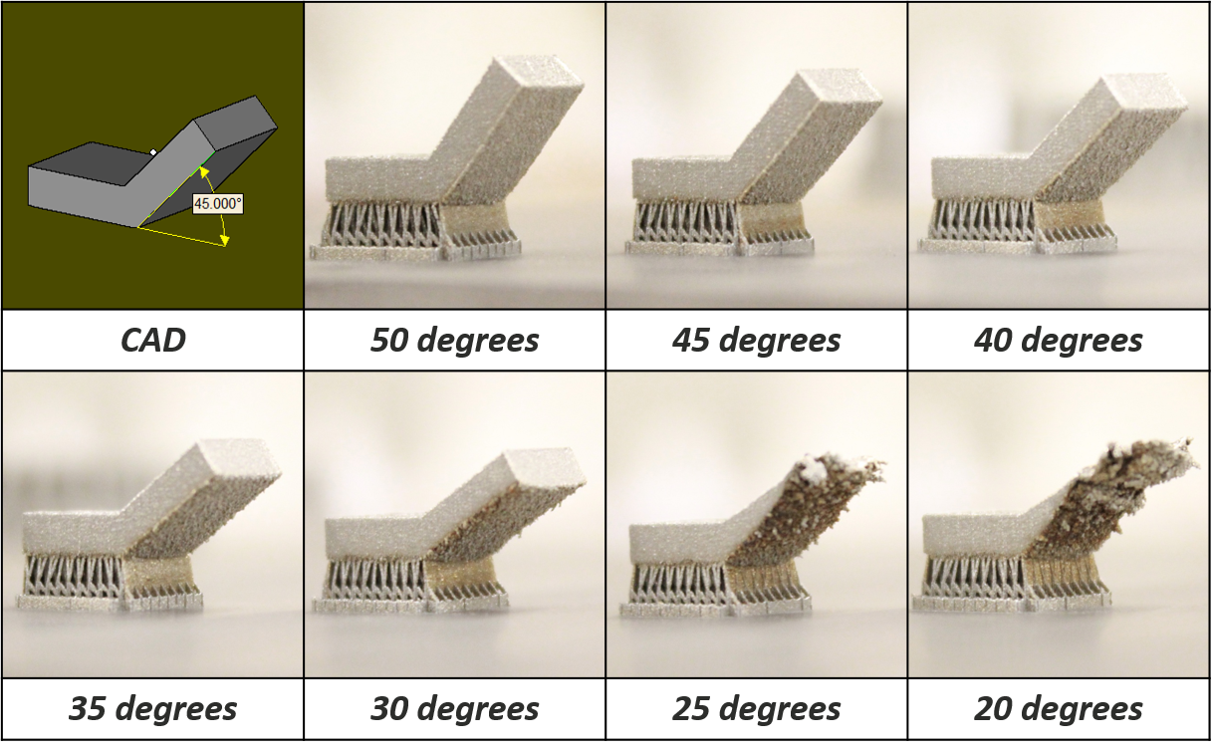
OVERHANGING ANGLES

Slide 50
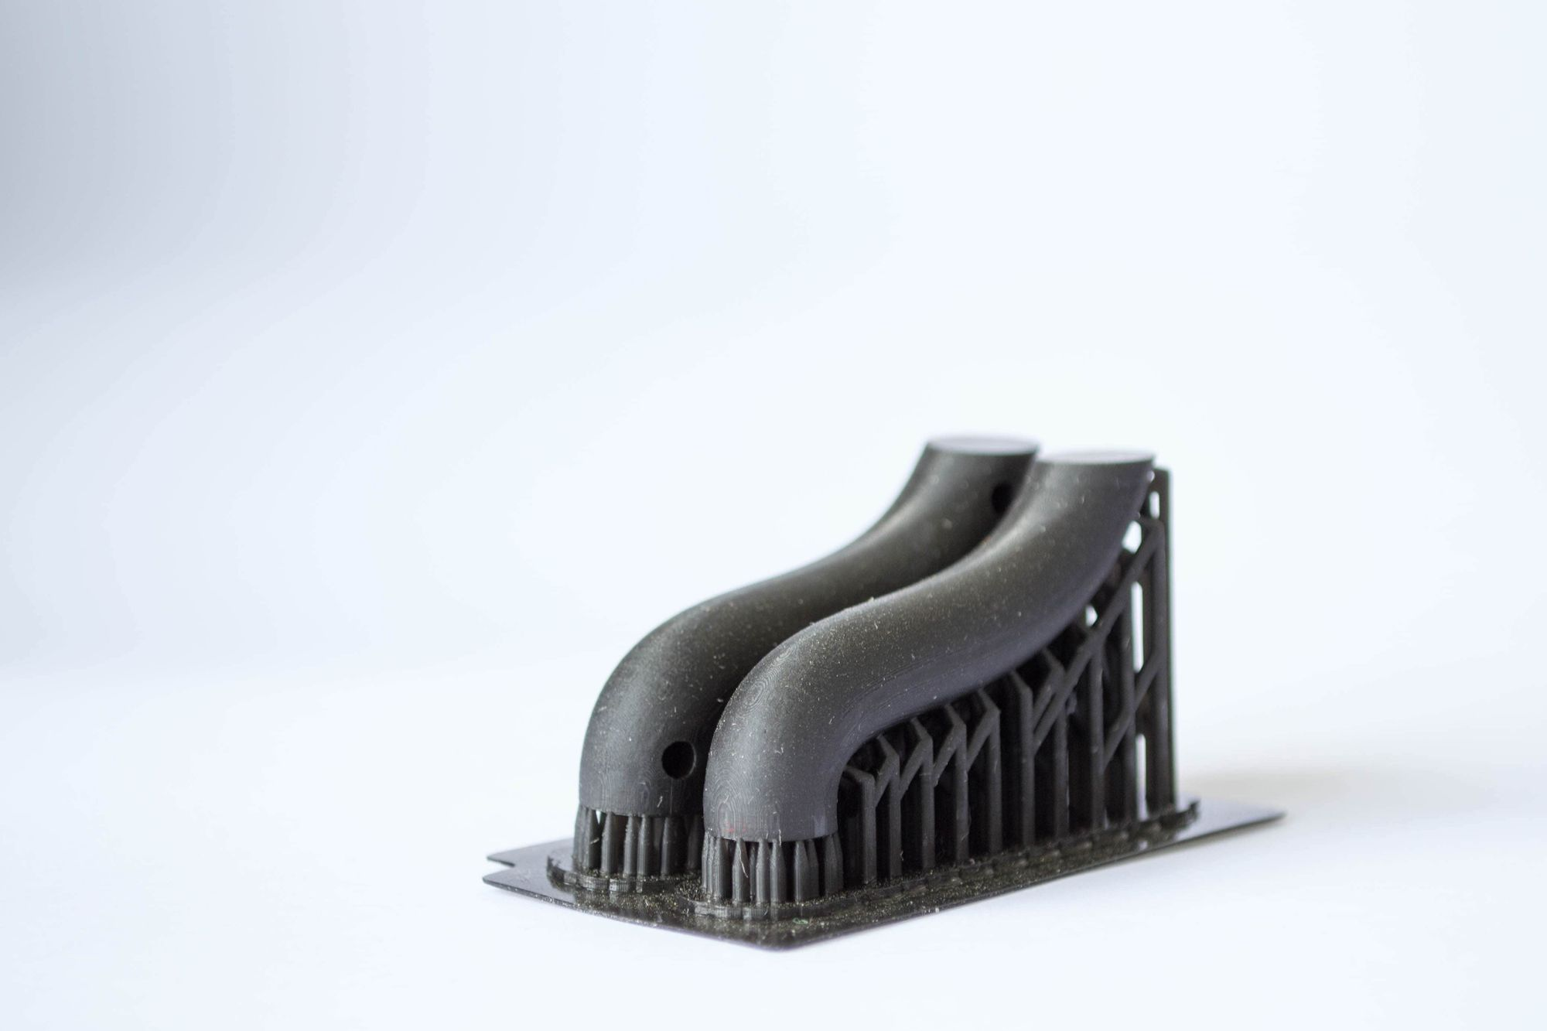
SUPPORT

Slide 51
LET’S HAVE SOME FUN

Slide 52
THANK YOU

